Slide 1

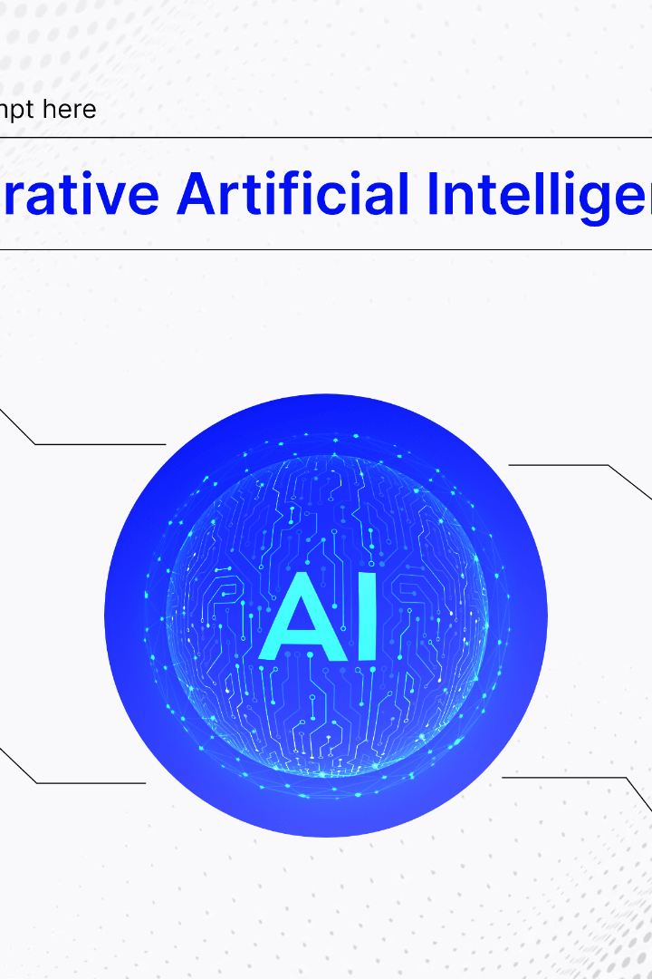

Presentation on Generative AI, ChatGPT4, and AI Automation and use of AI in Finance and Computational Finance
Discover the cutting-edge world of generative AI, explore the revolutionary capabilities of ChatGPT4, and delve into the exciting applications of AI automation in finance and computational finance.
by kolluru saharsh

Slide 2

The Power of Generative AI
1
Creative Innovations
2
Realistic Imagery
3
Interactive Design
With generative AI, computers can generate highly realistic images, bringing virtual worlds to life and enhancing various industries.
Generative AI transforms user experience by dynamically generating interactive designs that adapt to users' preferences and needs.
Generative AI enables the creation of original and compelling music, art, and literature, pushing the boundaries of human creativity.

Slide 3
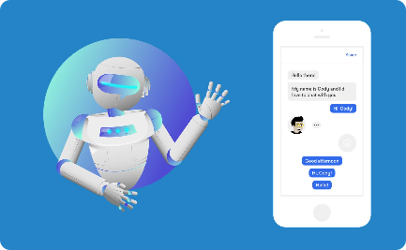


ChatGPT4: Revolutionizing Conversational AI
Seamless Customer Support
Virtual Assistants
Breaking Language Barriers
ChatGPT4 serves as intelligent virtual assistants, delivering timely information and assisting users in various tasks.
ChatGPT4 provides efficient and personalized customer support, reducing response times and enhancing user satisfaction.
ChatGPT4 enables multilingual communication, facilitating effective global interactions and fostering cross-cultural understanding.

Slide 4
AI Automation in Finance
Streamlined Workflow
Improved Accuracy
Enhanced Security
AI-powered automation strengthens the security of financial transactions and systems by detecting and mitigating potential threats.
Through AI automation, financial processes such as data analysis, risk assessment, and reporting can be streamlined, saving time and resources.
AI automation minimizes human errors by meticulously analyzing large datasets, ensuring accurate financial predictions and decision-making.

Slide 5

The Role of AI in Computational Finance
1
Data Analysis
AI algorithms enable quick and precise analysis of complex financial data, facilitating informed investment decisions and risk management.
2
Algorithmic Trading
AI-driven trading algorithms leverage vast amounts of data, enabling faster, more accurate, and autonomous trading strategies.
3
Risk Assessment
Computational finance relies on AI models to predict and manage risks, enhancing portfolio optimization and hedging strategies.

Slide 6
Transforming Finance with AI
Data-driven Insights
Personalized Financial Services
AI algorithms extract valuable insights from financial data, empowering institutions with data-driven decision-making and innovation.
AI enables tailor-made financial advice and recommendations, enhancing customer experience and financial well-being.
Improved Fraud Detection
Optimized Portfolio Management
AI-powered systems analyze patterns and anomalies to detect and prevent fraudulent activities, safeguarding financial institutions and customers.
Through AI, finance professionals can optimize asset allocation, manage risks, and maximize return on investment for their clients.

Slide 7

The Future of AI in Finance
Digital Banking
Risk Management
AI will revolutionize digital banking by providing personalized financial advice, automating payments, and enhancing security.
AI algorithms will continue to improve risk assessment and mitigation techniques, ensuring more robust and resilient financial systems.
Fraud Detection
Quantitative Analysis
AI-powered fraud detection systems will further evolve, becoming even more effective in detecting and preventing financial fraud.
AI will play a crucial role in quantitative analysis, enabling more accurate modeling and valuation of financial instruments.

Slide 8

Conclusion: Embracing AI for Future Finance
Generative AI, ChatGPT4, and AI automation revolutionize the finance industry, transforming operations, customer experience, and decision-making processes.
Computational finance leverages AI to optimize data analysis, risk assessment, and portfolio management, driving innovation and efficiency.
Embrace the future of finance by harnessing the power of AI, unlocking new possibilities, and staying ahead in an ever-evolving industry.

